Slide 1

MAE 4425/5091 SPACE ENVIRONMENT LESSON 15 – REVIEW PART 2

Slide 2
COURSE REVIEW
Chapter 1 – Course Intro
Chapter 2 – The Vacuum Environment
Chapter 3 - Neutral Atmospheric Particles
Chapter 4 - Charged particles and plasma interactions with the spacecraft
Chapter 5 - The radiation environment
Chapter 6 - Orbital debris
Bio Readings - Human Effects

Slide 3
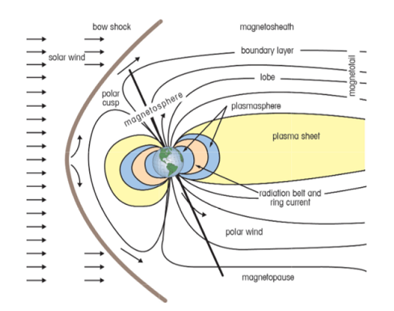
The Plasma Environment and Potential Effects
Notes:
“gas” of electrically charged particles with kinetic energy greater than the potential energy of attraction
(absolute value is rarely of concern)
Closely spaced surfaces create equilibrium by forming a current path
EMI is a problem for sensitive electronics
Effects are similar to the neutral environment
Outgassed materials ionized by solar UV are reattracted to the negatively charged spacecraft (particularly significant in GEO orbits)
Plasma is the most abundant matter in the universe, comprising as much as 99% of the universe’s mass. Plasma consists of neutral particles, positive ions, and electrons. Spacecraft operate in distinctly different plasma environments depending on their mission parameters. Interactions between the plasma regions and the spacecraft cause anomalies as minor as single event upsets (computer bit flips), or as major as degraded performance and damage to electronic components.

Slide 4
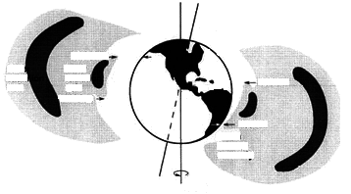
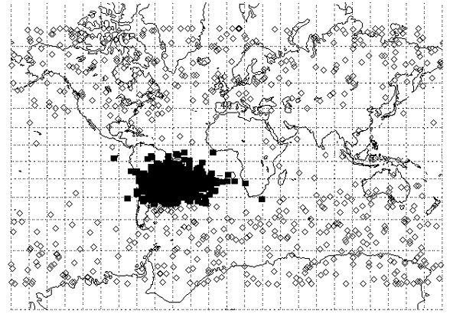
The Van Allen Radiation Belts
Magnetic
Axis
1200 km
Outer
Belt
Inner
Belt
800 km
1300 km
200 km
South
Atlantic
Anomaly
Earth’s
Rotational Axis
http://aoss.engin.umich.edu/earth_space/
courtesy of The Aerospace Corporation
Radiation belts define a natural upper limit to “low-Earth orbit” of ~ 900 km
Electron Belts (E > 0.5 MeV)
SMAD, Fig 8.7
Proton Belt (E > 100 MeV)
SMAD, Fig 8.8
The South Atlantic Anomaly: Single Event Upsets
on the
USAF Technology Autonomous Operational Survivability (TAOS) satellite
http://envnet.gsfc.nasa.gov/
Papers/Reno98.html
Notes:
The Earth’s magnetic field creates a “force field” to protect us from thes energetic particles, but …
some are trapped to gyrate back and forth along the Earth’s magnetic field lines (Van Allen radiation belts)
-- two regions of electrons (peak densities at 3000 km and 25000 km)
-- one region of protons (peak density at 3000 km)
Van Allen belt effects tend to be most significant in polar orbits
550 km, nearly polar orbit
47% of SEUs occurred in the South Atlantic Anomaly despite the fact that only 5% of the total orbital time was spent in this area

Slide 5
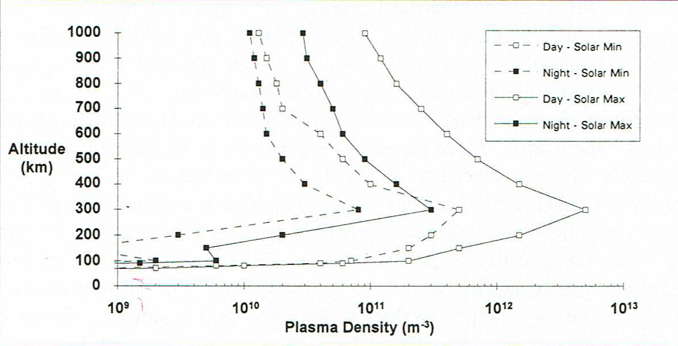
PLASMA DENSITY IN LEO

Slide 6
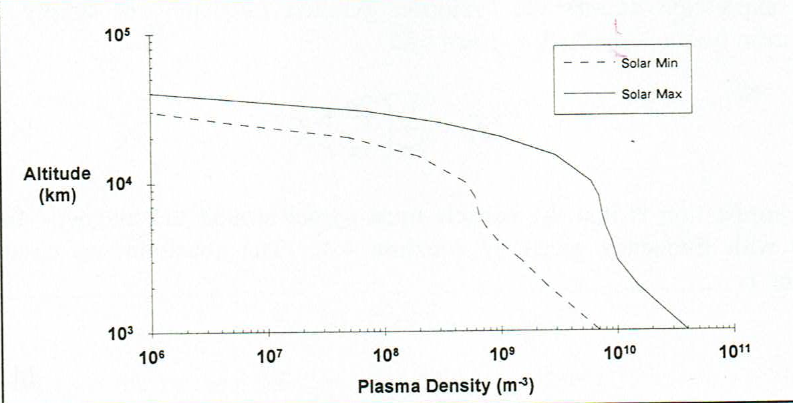
PLASMA DENSITY AT HIGHER ALTITUDES

Slide 7
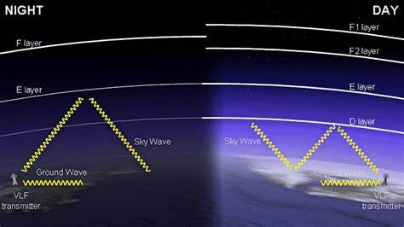
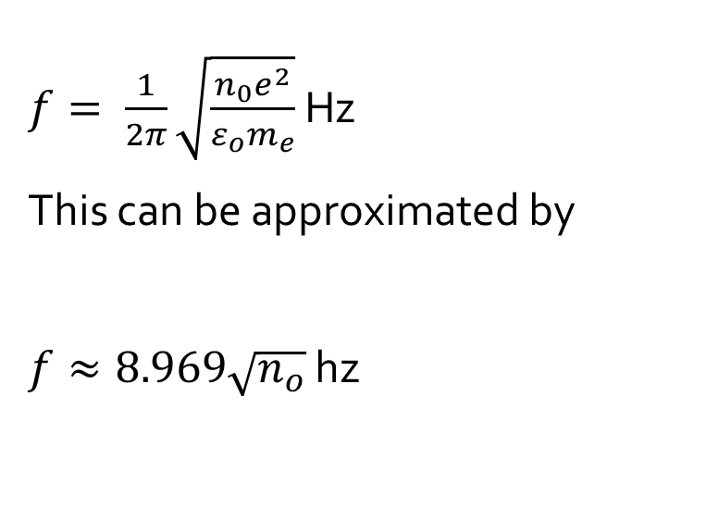
Plasma frequency of oscillation
$f= \frac{1}{2π}\sqrt{\frac{n_{0}e^{2}}{ε_{o}m_{e}}}$ Hz
This can be approximated by
$f≈8.969\sqrt{n_{o}}$ hz

Slide 8
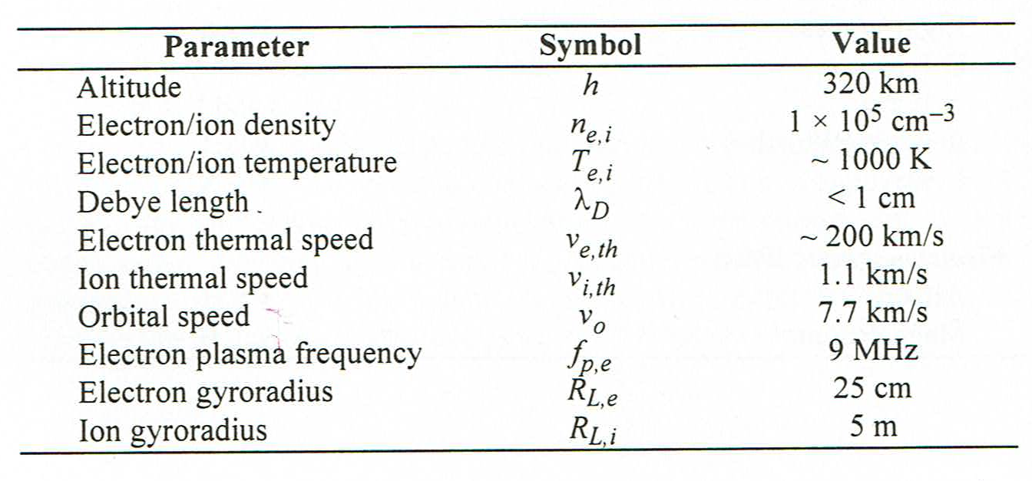
Spacecraft charging ionosphere plasma characteristics

Slide 9
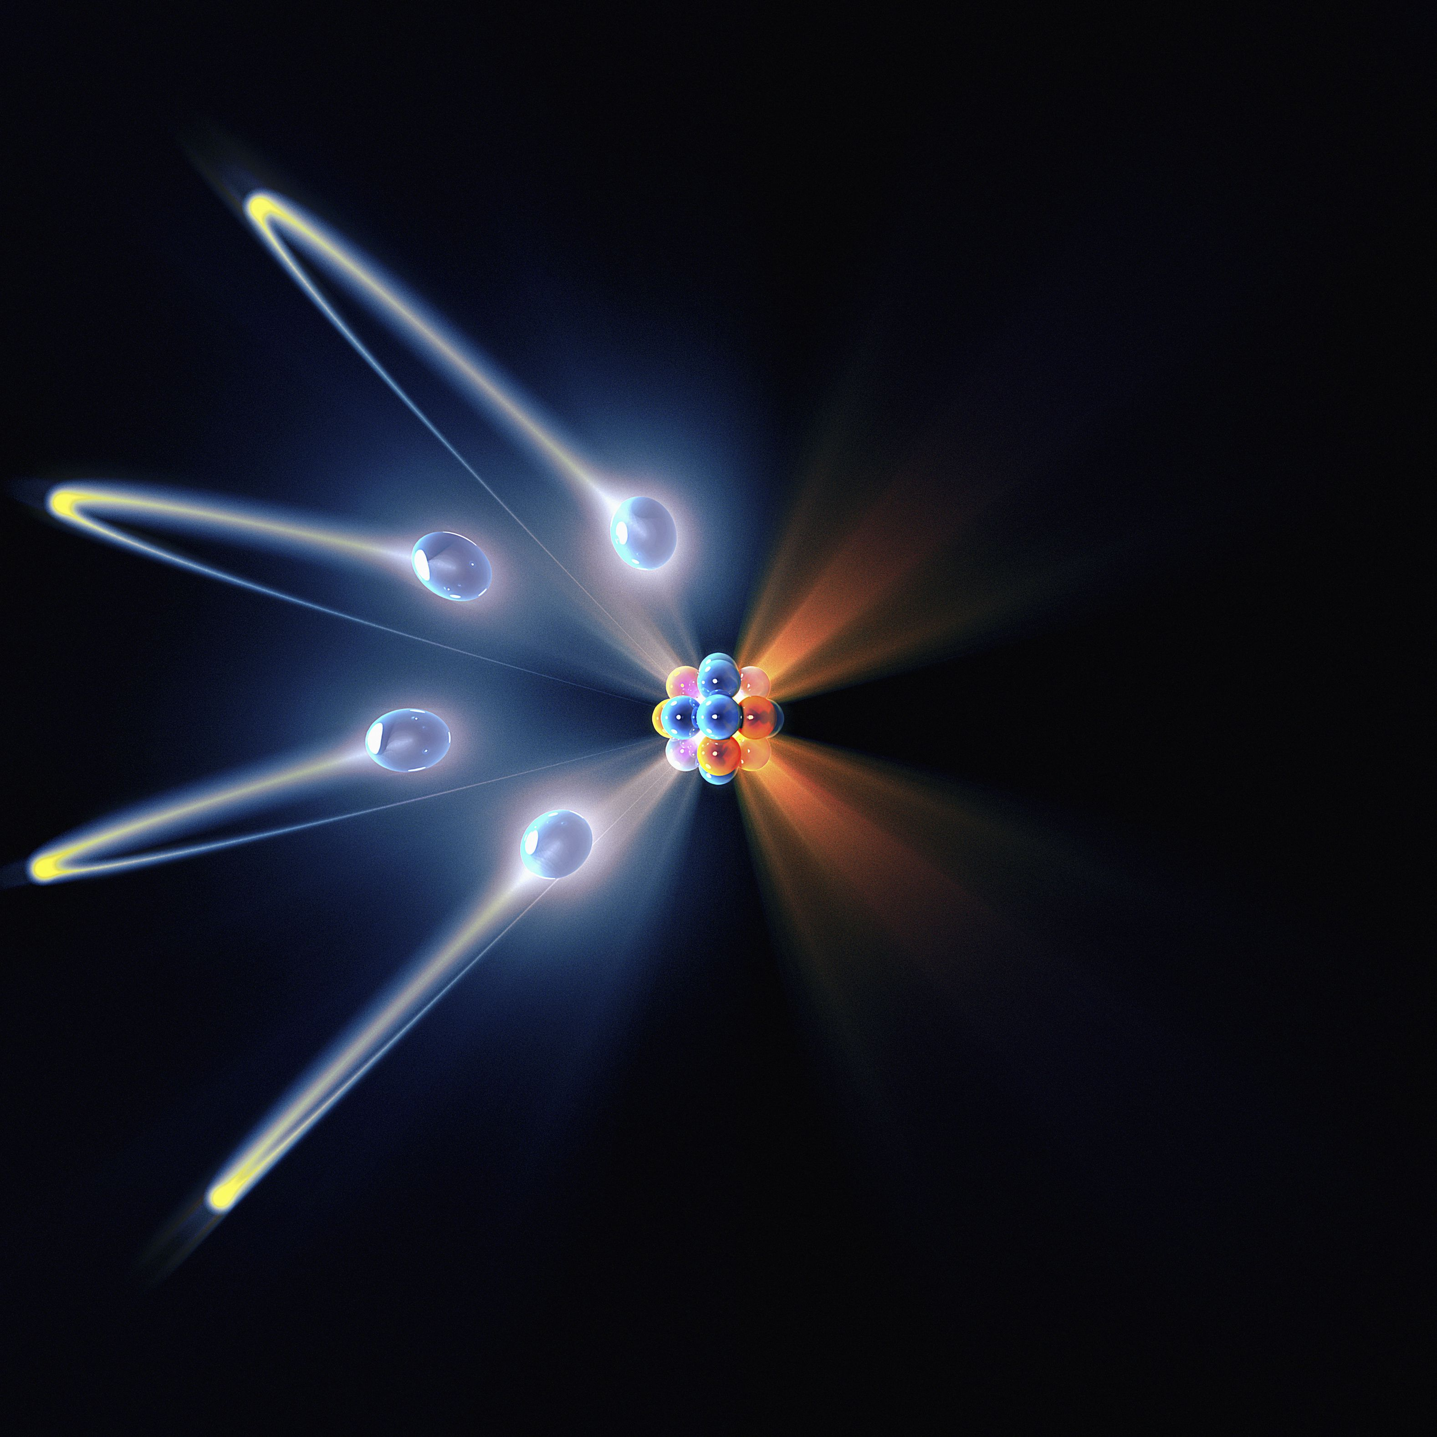
Mean or average speed of electrons and protons
$V_{mean}= \sqrt{\frac{8k_{B}T}{πm}}$
Where
$$k_{b}=Boltzmann^{′}s Constant=1.3806452 x {10}^{−23}J/K$$
T = Temperature (k)
$m$ = particle mass (kg)

Slide 10
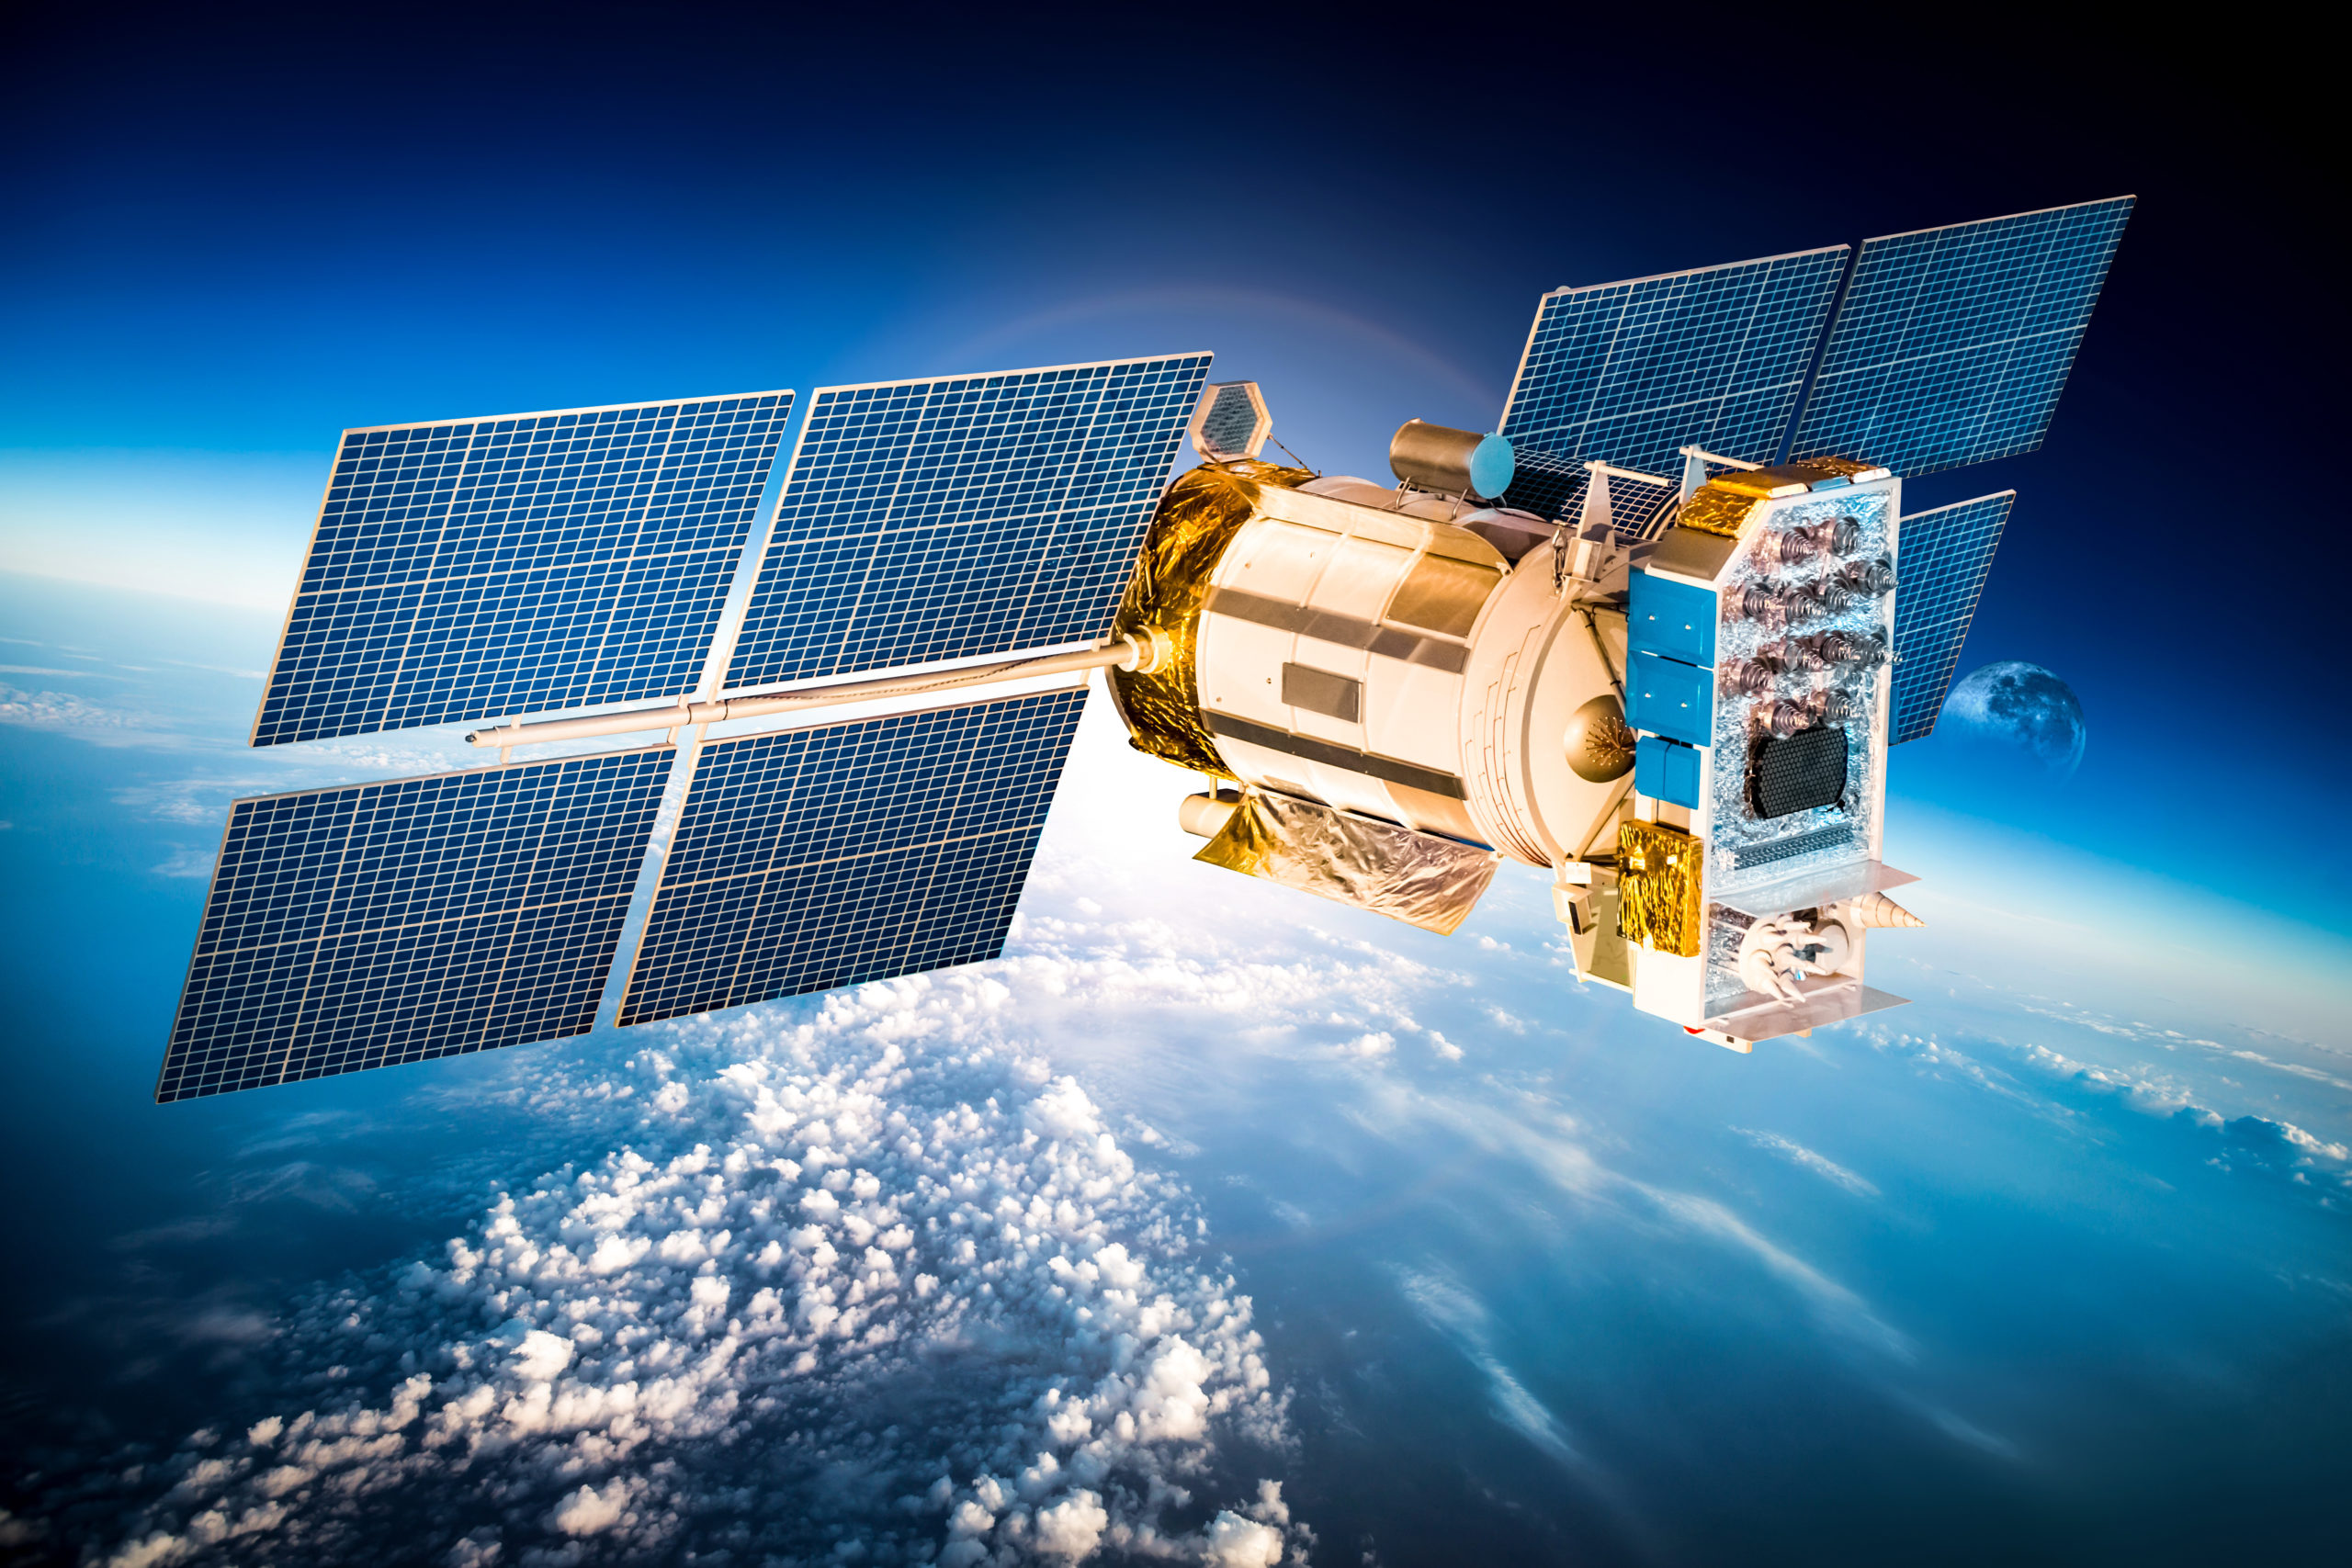
Biased object?
$I_{e}=I_{e,o}A_{e}e^{\frac{eV}{k_{B}T_{e}}}$ for V<0 (repelled)
$I_{e}=I_{e,o}A_{e}\left[1+\frac{eV}{k_{B}T_{e}}\right]$ for V>0 (attracted)
$$where$$
$I_{e,o}$ = current density /m-3
V = bias voltage
$e$ = charge (C)
$$k_{b}=Boltzmann^{′}s Constant$$
$=1.3806452 x {10}^{−23}J/K$
$T_{e}$ = electron temperature (K)
$$I_{e,o}=\frac{1}{4}en_{e}v_{e, mean}$$
Where
$n_{e}$=electron number density $m^{−3}$
$v_{e}$= electron speed

Slide 11

Biased object?
$I_{i}=I_{i,o}A_{i}e^{\frac{eV}{k_{B}T_{i}}}$ for V>0 (repelled)
$I_{i}=I_{i,o}A_{i}\left[1+\frac{eV}{k_{B}T_{i}}\right]$ for V<0 (attracted)
$$where$$
$I_{i,o}$ = current density$m^{−3}$
V = value of bias voltage
$e$ = charge (C)
$$k_{b}=Boltzmann^{′}s Constant$$
$=1.3806452 x {10}^{−23}J/K$
$T_{i}$ = ion temperature (K)
$$I_{i,o}=\frac{1}{4}en_{i}v_{i, mean}$$
Where
$n_{e}$= ion number density $m^{−3}$
$v_{e}$= ion speed

Slide 12
The Plasma Environment and Potential Effects
Problems include
Arcing (the dominant concern)
Electrostatic Discharge (point-to-point arcing) – caused by large potential differences between conductors and dielectrics
Dielectric Breakdown (arcing through a material) – caused by large potential differences through surfaces
Generates electromagnetic interference (EMI) and damages surfaces (damage to solar arrays and electronics of greatest concern)
Increased currents: may alter floating potential or drain available power
Ion drag: may add to orbit decay
Ion sputtering: may increase erosion of surfaces
Re-attraction of contamination: may be significant in degrading surfaces
Notes:
“gas” of electrically charged particles with kinetic energy greater than the potential energy of attraction
(absolute value is rarely of concern)
Closely spaced surfaces create equilibrium by forming a current path
EMI is a problem for sensitive electronics
Effects are similar to the neutral environment
Outgassed materials ionized by solar UV are reattracted to the negatively charged spacecraft (particularly significant in GEO orbits)

Slide 13
SUMMARY – PLASMA ENVIRONMENT
Know the effects of the plasma environment on spacecraft
Describe the causes of the Van Allen radiation belts
Understand the main characteristics of each plasma region (D E F1 F2)
Describe how solar flares, CMEs and sunspot activity affect ionospheric density and electron content
Calculate the plasma frequency of each level
Know main effects on signals including time delays and excess range
Demonstrate an understanding of plasma effects on spacecraft
Find expected induced currents due to the plasma environment
Propose appropriate voltage biasing to reduce charging effects
Notes:
No convective heat transfer
All radiation with wavelengths less than 0.3 microns is absorbed by the ozone layer, but not so on orbit
Film deposits and no window cleaner

Slide 14
COURSE REVIEW
Chapter 1 – Course Intro
Chapter 2 – The Vacuum Environment
Chapter 3 - Neutral Atmospheric Particles
Chapter 4 - Charged particles and plasma interactions with the spacecraft
Chapter 5 - The radiation environment
Chapter 6 - Orbital debris
Bio Readings - Human Effects

Slide 15
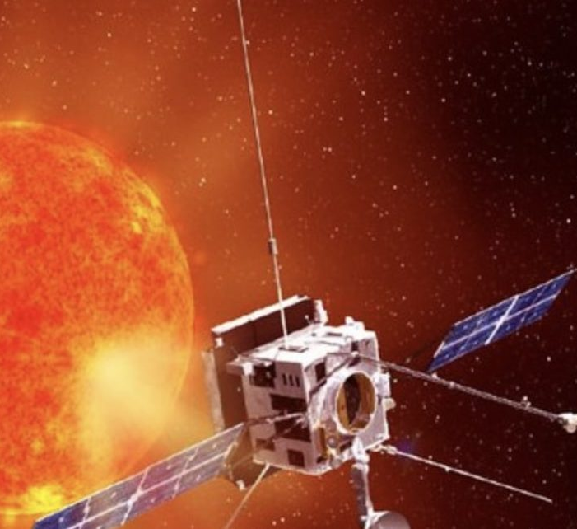
Radiation Environment and Its Effects
Radiation is any object that deposits energy in a material
Charged particles (electrons, protons)
Uncharged particles (neutrons)
Photons (gamma rays, x-rays)
Notes:
Energy transfer vs. charging
Energetic particles may displace or ionize material in their paths (also deposit energy to induce more low energy effects)
Dominant source depends on orbit
A variety of naturally occurring sources exist
Ionization and atomic displacement reduce the current and power that a cell can produce
Similar to solar cell degradation
No response to inputs
Functions in a manner inconsistent with its design characteristics (e.g., memory register changes state)
“soft” -- bit flips
“hard” -- permanent damage

Slide 16
Radiation Environment and Its Effects
Radiation is any object that deposits energy in a material
Charged particles (electrons, protons)
Uncharged particles (neutrons)
Photons (gamma rays, x-rays)
Radiation sources
Solar particle events (SPE), highest during peaks in the solar cycle
Trapped radiation in the Van Allen Belts
Galactic cosmic rays (GCR): mostly hydrogen and helium ions
Important effects
Solar cell degradation is a function of time
GaAs cells are more resistant than Si, but cost more
Degradation of electronics and materials
Can degrade mechanical, electrical and thermal properties of materials
Single event phenomena (SEP)
Can result in upset, latchup, or burnout
Notes:
Energy transfer vs. charging
Energetic particles may displace or ionize material in their paths (also deposit energy to induce more low energy effects)
Dominant source depends on orbit
A variety of naturally occurring sources exist
Ionization and atomic displacement reduce the current and power that a cell can produce
Similar to solar cell degradation
No response to inputs
Functions in a manner inconsistent with its design characteristics (e.g., memory register changes state)
“soft” -- bit flips
“hard” -- permanent damage

Slide 17
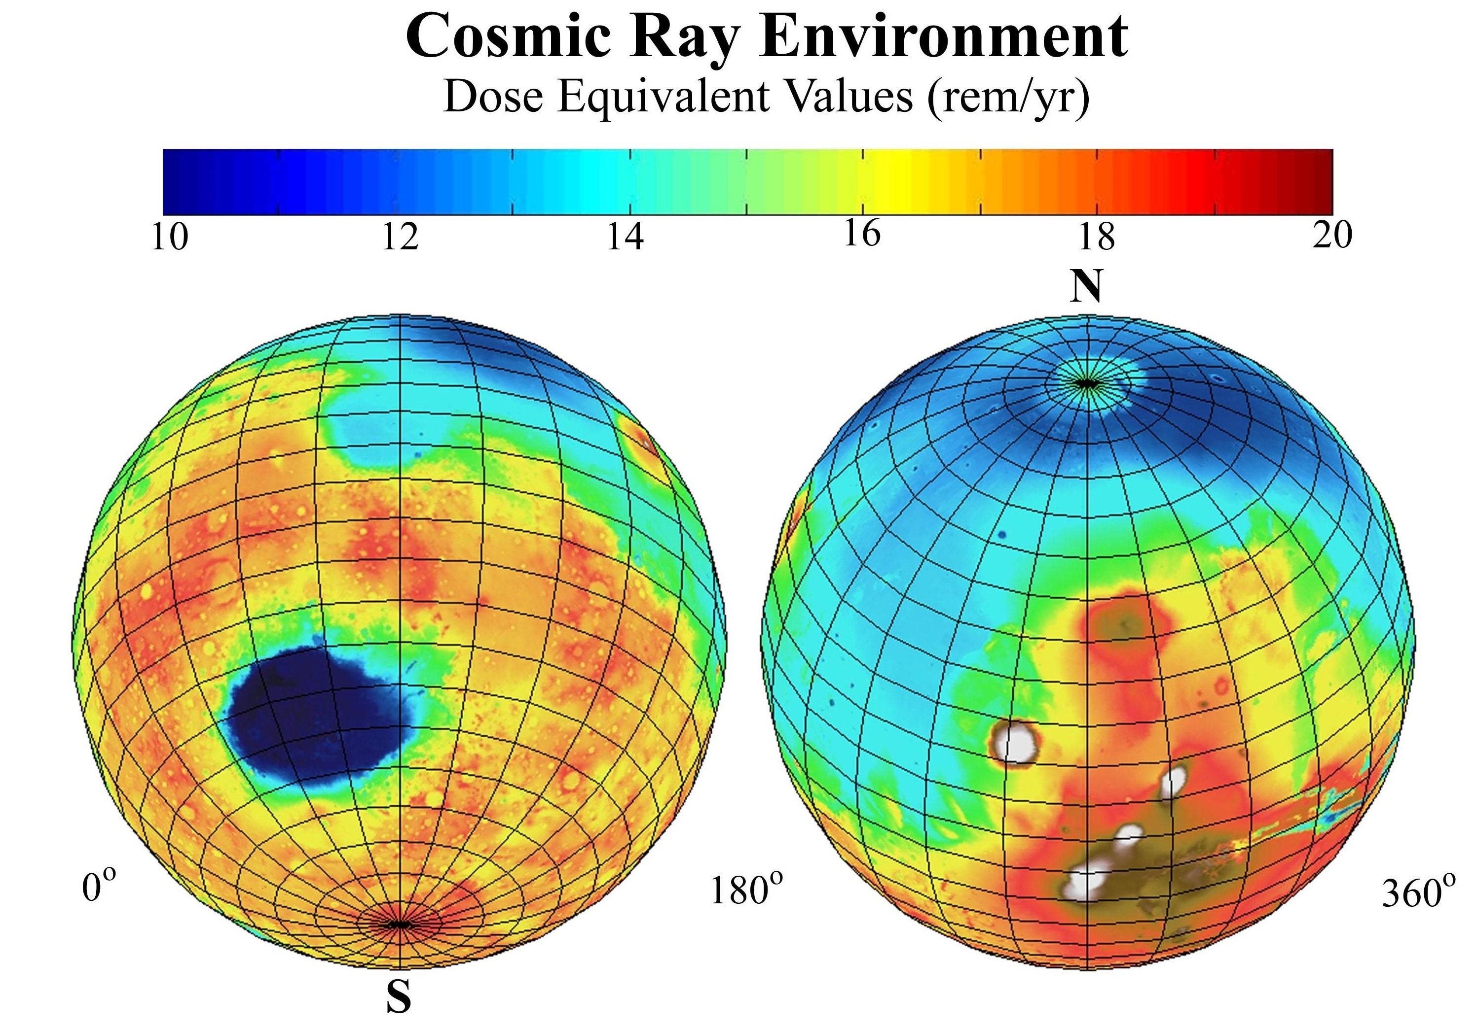
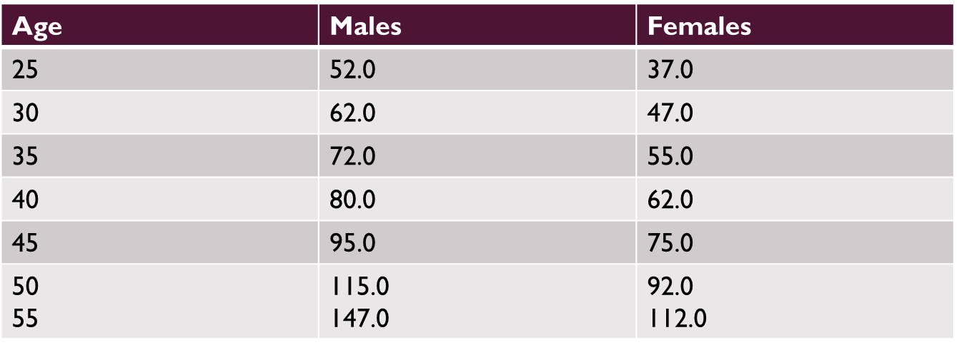

RADIATION EFFECTS ON HUMANS
Typical radiation tolerance figures - These are example career effective dose limits in units of REM for 1 year missions.

Slide 18
ATTITUDE DETERMINATION AND CONTROL SYSTEM
Four main Disturbances:
Gravity Gradient
Solar Radiation
Magnetic Field
Aerodynamic

Slide 19

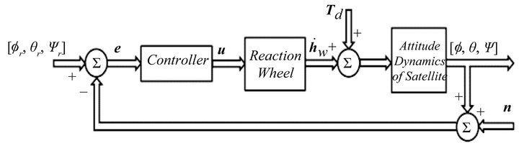

REACTION WHEEL SIZING
$$T_{D}=Disturbance Torque= ?$$

Slide 20
Estimating Worst-Case Environmental Disturbance Torques
SMAD, Table 11.9A
Cyclic torques oscillate over an orbit. Attitude control system must provide enough angular momentum storage to accommodate variations
Secular torques accumulate with time causing momentum storage devices to saturate. Momentum must be dumped (using thrusters or magnetic torquers) to maintain control authority.
Notes:
Should emphasize the difference between cyclic and secular torques.

Slide 21
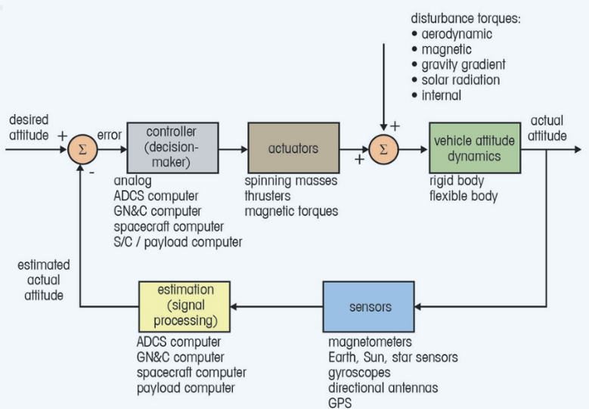
SUMMARY
ADCS Design Process
Quantifying Disturbances
Selecting and Sizing ADCS Hardware

Slide 22
SUMMARY – RADIATION ENVIRONMENT
Understand the effects of the radiation environment on spacecraft and humans
Describe the main sources of radiation in space
Know NASA recommended limits of radiation exposure to humans
Demonstrate an understanding of the effects of radiation on spacecraft design
Notes:
No convective heat transfer
All radiation with wavelengths less than 0.3 microns is absorbed by the ozone layer, but not so on orbit
Film deposits and no window cleaner

Slide 23
SUMMARY – ADACS
Describe typical satellite ADACS subsystems including
Sensors and actuators
Active and passive systems
Calculate the magnitude of disturbances due to
Gravity gradient
Magnetic fields
Solar radiation pressure
Aerodynamics Drag
Slew maneuvers
Design an ADACS subsystem to meet your mission’s needs
Notes:
No convective heat transfer
All radiation with wavelengths less than 0.3 microns is absorbed by the ozone layer, but not so on orbit
Film deposits and no window cleaner

Slide 24
COURSE REVIEW
Chapter 1 – Course Intro
Chapter 2 – The Vacuum Environment
Chapter 3 - Neutral Atmospheric Particles
Chapter 4 - Charged particles and plasma interactions with the spacecraft
Chapter 5 - The radiation environment
Chapter 6 - Orbital debris
Bio Readings - Human Effects

Slide 25
Micro-Meteoroids and Orbital Debris
Natural and man-made objects with high velocities
Typical meteoroid velocities – 10 to 20 km/s relative to Earth
Relative velocities between satellites and man-made debris average 9 to 10 km/s in LEO and 100 to 500 m/s in GEO
Notes:
But natural environment does not pose a serious hazard to most Earth-orbiting spacecraft
Spacecraft structure is the first line of defense, but active techniques such as shielding (space station) and maneuvering may be used. (But remember, predicted impacts may not be accurate.)
Perhaps over 20,000 objects of diameter 4 cm or more
In LEO, debris as small as 0.1% of spacecraft mass can cause a spacecraft to break into many fragments
Orbital regions where impact with large (> 10 cm) or medium (> 1 cm) is most likely: 750-1000 km and 1500 km
Spacecraft in semi-synchronous or GEO orbits are about 100 time less likely to be struck
Very low orbits have less debris problems because of drag

Slide 26
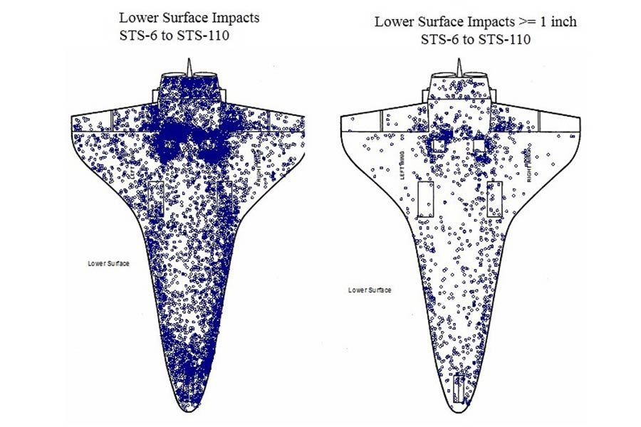
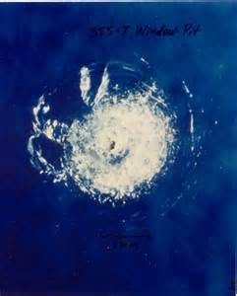

Slide 27
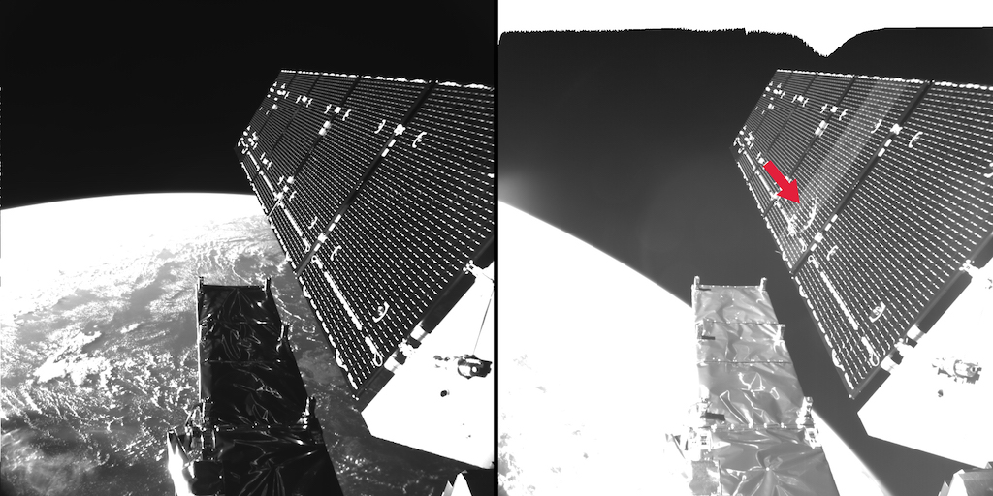
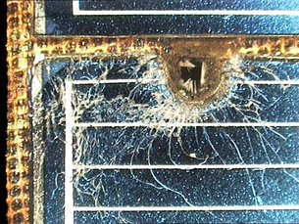

Slide 28
Spacecraft design implications
1) Enhance protection by using stronger materials or shielding
2) Reduce area of vulnerable surface
3) Relocate critical items
4) Compartmentalize the interior
5) Redundancy
6) Automatic isolation
7) Avoid orbits with large amounts of orbital debris
8) Safe mode!

Slide 29
SUMMARY – MMOD
Know the main sources of space junk
Understand risks to spacecraft due to very high speed objects
Describe design implications to protect spacecraft from orbital debris
Notes:
No convective heat transfer
All radiation with wavelengths less than 0.3 microns is absorbed by the ozone layer, but not so on orbit
Film deposits and no window cleaner

Slide 30
Summary of Environment Effects
Notes:
To summarize, here are the environmental effects you have to consider as you investigate spacecraft orbits

Slide 31
Impact of the Space Environment on Spacecraft Systems
Space Environments
Vacuum | Neutral | Plasma | Radiation | MM/OD
Spacecraft Subsystems | Solar UV | Outgassing/ Contamination | Aerodynamic Drag | Sputtering | Atomic Oxygen | Spacecraft Glow | Spacecraft Charging | Van Allen Belts | Galactic Cosmic Rays | Solar Proton Events | Impacts
Attitude Determination & Control |  | Degradation of sensors | Induced torques |  |  | Interference with sensors | Torques due to induced potentials
Avionics |  |  |  |  |  |  | Upsets due to EMI from arcing |  |  |  | EMI due to impacts
Electrical Power |  |  |  |  |  |  | Shift in floating potential, reattraction of contaminants |  |  |  | Destruction/ obscuration of solar cells
Propulsion |  | Thruster plumes may be a contaminant source | Drag makeup fuel requirement |  |  |  | Shift in floating potential due to thruster firings |  |  |  | Rupture of pressurized tanks
Structures |  |  |  |  |  |  |  |  |  |  | Penetration
Telemetry, Tracking & Communications |  | Degradation of sensors |  |  |  | Interference with sensors | EMI due to arcing |  |  |  | EMI due to impacts
Thermal Control |  |  |  |  |  |  | Reattraction of comtaminants |  |  |  | Degradation of alpha/epsilon
Change in sensor coatings
Degradation: SEUs, bit errors, …
Change in coverslide transmittance
Change in coverslide transmittance
Degradation of solar cell output
Change in sensor coatings
Degradation of electronics
Change in surface alpha/epsilon ratio
Change in surface alpha/epsilon ratio
Cold surfaces may experience heating
TSE, Fig 7.1
Notes:
A variety of environmental effects have a direct impact on the ability of spacecraft subsystems to execute their design objectives
This chart provides a good summary of the impacts of the space environment on these subsystems
⇒ we’ll walk through each of these areas in the next several slides
Must recognize that extra margin must be designed into spacecraft subsystems to handle these impacts

Slide 32
COURSE REVIEW
Chapter 1 – Course Intro
Chapter 2 – The Vacuum Environment
Chapter 3 - Neutral Atmospheric Particles
Chapter 4 - Charged particles and plasma interactions with the spacecraft
Chapter 5 - The radiation environment
Chapter 6 - Orbital debris
Bio Readings - Human Effects

Slide 33
SUMMARY – BIO-ASTRONAUTICS
Be familiar with all of it!
~30% on bio-astronautics
Know main effects on the human body of free-fall
Hydrostatic gradient
Reduced load on weight bearing tissues
Altered vestibular functions
History of human spaceflight
Psychological considerations
Notes:
No convective heat transfer
All radiation with wavelengths less than 0.3 microns is absorbed by the ozone layer, but not so on orbit
Film deposits and no window cleaner

Slide 34

Lesson 15
Current Events
Review course objectives
Space Resources
Course Review
Final Logistics
Final Project

Slide 35
FINAL QUIZ
2.5 HOURS
15 QUESTIONS
FINAL PROJECT
Write a report documenting your design process from beginning to end. Your report must be clear, professional and well-organized. Write the report as if your design team is selling your design to win the contract for your selected mission. Include appropriate results to defend your design.
Notes:
No convective heat transfer
All radiation with wavelengths less than 0.3 microns is absorbed by the ozone layer, but not so on orbit
Film deposits and no window cleaner

